Slide 1
Chapter 26: Data Mining
(Some slides courtesy of
Rich Caruana, Cornell University)

Slide 2
Definition
Data mining is the exploration and analysis of large quantities of data in order to discover valid, novel, potentially useful, and ultimately understandable patterns in data.
Example pattern (Census Bureau Data):
If (relationship = husband), then (gender = male). 99.6%

Slide 3
Definition (Cont.)
Data mining is the exploration and analysis of large quantities of data in order to discover valid, novel, potentially useful, and ultimately understandable patterns in data.
Valid: The patterns hold in general.
Novel: We did not know the pattern beforehand.
Useful: We can devise actions from the patterns.
Understandable: We can interpret and comprehend the patterns.

Slide 4
Why Use Data Mining Today?
Human analysis skills are inadequate:
  Volume and dimensionality of the data
  High data growth rate
Availability of:
  Data
  Storage
  Computational power
  Off-the-shelf software
  Expertise

Slide 5
An Abundance of Data
Supermarket scanners, POS data
Preferred customer cards
Credit card transactions
Direct mail response
Call center records
ATM machines
Demographic data
Sensor networks
Cameras
Web server logs
Customer web site trails

Slide 6
Evolution of Database Technology
1960s: IMS, network model
1970s: The relational data model, first relational DBMS implementations
1980s: Maturing RDBMS, application-specific DBMS, (spatial data, scientific data, image data, etc.), OODBMS
1990s: Mature, high-performance RDBMS technology, parallel DBMS, terabyte data warehouses, object-relational DBMS, middleware and web technology
2000s: High availability, zero-administration, seamless integration into business processes
2010: Sensor database systems, databases on embedded systems, P2P database systems, large-scale pub/sub systems, ???

Slide 7

Computational Power
Moore’s Law:
In 1965, Intel Corporation cofounder Gordon Moore predicted that the density of transistors in an integrated circuit would double every year.
(Later changed to reflect 18 months progress.)
Experts on ants estimate that there are 10¹⁶ to 10¹⁷ ants on earth. In the year 1997, we produced one transistor per ant.

Slide 8
Much Commercial Support
Many data mining tools
  http://www.kdnuggets.com/software
Database systems with data mining support
Visualization tools
Data mining process support
Consultants

Slide 9
Why Use Data Mining Today?
Competitive pressure!
“The secret of success is to know something that nobody else knows.”
Aristotle Onassis
Competition on service, not only on price (Banks, phone companies, hotel chains, rental car companies)
Personalization, CRM
The real-time enterprise
“Systemic listening”
Security, homeland defense

Slide 10
The Knowledge Discovery Process
Steps:
Identify business problem
Data mining
Action
Evaluation and measurement
Deployment and integration into businesses processes

Slide 11
Data Mining Step in Detail
2.1 Data preprocessing
  Data selection: Identify target datasets and relevant fields
  Data cleaning
    Remove noise and outliers
    Data transformation
    Create common units
    Generate new fields
2.2 Data mining model construction
2.3 Model evaluation

Slide 12
Preprocessing and Mining
Knowledge
Patterns
Preprocessed
Data
Target
Data
Interpretation
Model
Construction
Original Data
Preprocessing
Data
Integration
and Selection

Slide 13

Example Application: Sports
IBM Advanced Scout analyzes
NBA game statistics
  Shots blocked
  Assists
  Fouls
Google: “IBM Advanced Scout”

Slide 14

Advanced Scout
Example pattern: An analysis of the
data from a game played between
the New York Knicks and the Charlotte
Hornets revealed that “When Glenn Rice played the shooting guard position, he shot 5/6 (83%) on jump shots."
Pattern is interesting:
The average shooting percentage for the Charlotte Hornets during that game was 54%.

Slide 15
Example Application: Sky Survey
Input data: 3 TB of image data with 2 billion sky objects, took more than six years to complete
Goal: Generate a catalog with all objects and their type
Method: Use decision trees as data mining model
Results:
  94% accuracy in predicting sky object classes
  Increased number of faint objects classified by 300%
  Helped team of astronomers to discover 16 new high red-shift quasars in one order of magnitude less observation time

Slide 16
Gold Nuggets?
Investment firm mailing list: Discovered that old people do not respond to IRA mailings
Bank clustered their customers. One cluster: Older customers, no mortgage, less likely to have a credit card
“Bank of 1911”
Customer churn example

Slide 17
What is a Data Mining Model?
A data mining model is a description of a specific aspect of a dataset. It produces output values for an assigned set of input values.
Examples:
Linear regression model
Classification model
Clustering

Slide 18
Data Mining Models (Contd.)
A data mining model can be described at two levels:
Functional level:
  Describes model in terms of its intended usage.
  Examples: Classification, clustering
Representational level:
  Specific representation of a model.
  Example: Log-linear model, classification tree, nearest neighbor method.
Black-box models versus transparent models

Slide 19
Data Mining: Types of Data
Relational data and transactional data
Spatial and temporal data, spatio-temporal observations
Time-series data
Text
Images, video
Mixtures of data
Sequence data
Features from processing other data sources

Slide 20
Types of Variables
Numerical: Domain is ordered and can be represented on the real line (e.g., age, income)
Nominal or categorical: Domain is a finite set without any natural ordering (e.g., occupation, marital status, race)
Ordinal: Domain is ordered, but absolute differences between values is unknown (e.g., preference scale, severity of an injury)

Slide 21
Data Mining Techniques
Supervised learning
  Classification and regression
Unsupervised learning
  Clustering
Dependency modeling
  Associations, summarization, causality
Outlier and deviation detection
Trend analysis and change detection

Slide 22
Supervised Learning
F(x): true function (usually not known)
D: training sample drawn from F(x)
57,M,195,0,125,95,39,25,0,1,0,0,0,1,0,0,0,0,0,0,1,1,0,0,0,0,0,0,0,0 78,M,160,1,130,100,37,40,1,0,0,0,1,0,1,1,1,0,0,0,0,0,0,0,0,0,0,0,0,0 69,F,180,0,115,85,40,22,0,0,0,0,0,1,0,0,0,0,1,0,0,0,0,0,0,0,0,0,0,0,0 18,M,165,0,110,80,41,30,0,0,0,0,1,0,0,0,0,0,0,0,0,0,0,0,0,0,0,0,0,0 54,F,135,0,115,95,39,35,1,1,0,0,0,1,0,0,0,1,0,0,0,0,1,0,0,0,1,0,0,0,0 84,F,210,1,135,105,39,24,0,0,0,0,0,0,0,0,1,0,0,0,0,0,0,0,0,0,0,0,0,0 89,F,135,0,120,95,36,28,0,0,0,0,0,0,0,0,0,0,0,0,1,1,0,0,0,0,0,0,1,0,0 49,M,195,0,115,85,39,32,0,0,0,1,1,0,0,0,0,0,0,1,0,0,0,0,0,1,0,0,0,0 40,M,205,0,115,90,37,18,0,0,0,0,0,0,0,0,0,0,0,0,0,0,0,0,0,0,0,0,0,0 74,M,250,1,130,100,38,26,1,1,0,0,0,1,1,0,0,0,0,0,0,0,0,0,0,0,0,0,0 77,F,140,0,125,100,40,30,1,1,0,0,0,0,0,0,0,0,1,0,0,0,0,0,0,0,0,0,1,1 | 0 1 0 1 1 0 1 0 0 1 0

Slide 23
Supervised Learning
F(x): true function (usually not known)
D: training sample (x,F(x))
57,M,195,0,125,95,39,25,0,1,0,0,0,1,0,0,0,0,0,0,1,1,0,0,0,0,0,0,0,0 0
78,M,160,1,130,100,37,40,1,0,0,0,1,0,1,1,1,0,0,0,0,0,0,0,0,0,0,0,0,0 1
69,F,180,0,115,85,40,22,0,0,0,0,0,1,0,0,0,0,1,0,0,0,0,0,0,0,0,0,0,0,0 0
18,M,165,0,110,80,41,30,0,0,0,0,1,0,0,0,0,0,0,0,0,0,0,0,0,0,0,0,0,0 0
54,F,135,0,115,95,39,35,1,1,0,0,0,1,0,0,0,1,0,0,0,0,1,0,0,0,1,0,0,0,0 1
G(x): model learned from D 71,M,160,1,130,105,38,20,1,0,0,0,0,0,0,0,0,0,1,0,0,0,0,0,0,0,0,0,0 ?
Goal: E[(F(x)-G(x))²] is small (near zero) for future samples

Slide 24
Supervised Learning
Well-defined goal:
Learn G(x) that is a good approximation
to F(x) from training sample D
Well-defined error metrics:
Accuracy, RMSE, ROC, …

Slide 25
Supervised Learning
Training dataset:
Test dataset:
71,M,160,1,130,105,38,20,1,0,0,0,0,0,0,0,0,0,1,0,0,0,0,0,0,0,0,0,0 ?
57,M,195,0,125,95,39,25,0,1,0,0,0,1,0,0,0,0,0,0,1,1,0,0,0,0,0,0,0,0 78,M,160,1,130,100,37,40,1,0,0,0,1,0,1,1,1,0,0,0,0,0,0,0,0,0,0,0,0,0 69,F,180,0,115,85,40,22,0,0,0,0,0,1,0,0,0,0,1,0,0,0,0,0,0,0,0,0,0,0,0 18,M,165,0,110,80,41,30,0,0,0,0,1,0,0,0,0,0,0,0,0,0,0,0,0,0,0,0,0,0 54,F,135,0,115,95,39,35,1,1,0,0,0,1,0,0,0,1,0,0,0,0,1,0,0,0,1,0,0,0,0 84,F,210,1,135,105,39,24,0,0,0,0,0,0,0,0,1,0,0,0,0,0,0,0,0,0,0,0,0,0 89,F,135,0,120,95,36,28,0,0,0,0,0,0,0,0,0,0,0,0,1,1,0,0,0,0,0,0,1,0,0 49,M,195,0,115,85,39,32,0,0,0,1,1,0,0,0,0,0,0,1,0,0,0,0,0,1,0,0,0,0 40,M,205,0,115,90,37,18,0,0,0,0,0,0,0,0,0,0,0,0,0,0,0,0,0,0,0,0,0,0 74,M,250,1,130,100,38,26,1,1,0,0,0,1,1,0,0,0,0,0,0,0,0,0,0,0,0,0,0 77,F,140,0,125,100,40,30,1,1,0,0,0,0,0,0,0,0,1,0,0,0,0,0,0,0,0,0,1,1 | 0 1 0 1 1 0 1 0 0 1 0

Slide 26
Un-Supervised Learning
Training dataset:
Test dataset:
71,M,160,1,130,105,38,20,1,0,0,0,0,0,0,0,0,0,1,0,0,0,0,0,0,0,0,0,0 ?
57,M,195,0,125,95,39,25,0,1,0,0,0,1,0,0,0,0,0,0,1,1,0,0,0,0,0,0,0,0 78,M,160,1,130,100,37,40,1,0,0,0,1,0,1,1,1,0,0,0,0,0,0,0,0,0,0,0,0,0 69,F,180,0,115,85,40,22,0,0,0,0,0,1,0,0,0,0,1,0,0,0,0,0,0,0,0,0,0,0,0 18,M,165,0,110,80,41,30,0,0,0,0,1,0,0,0,0,0,0,0,0,0,0,0,0,0,0,0,0,0 54,F,135,0,115,95,39,35,1,1,0,0,0,1,0,0,0,1,0,0,0,0,1,0,0,0,1,0,0,0,0 84,F,210,1,135,105,39,24,0,0,0,0,0,0,0,0,1,0,0,0,0,0,0,0,0,0,0,0,0,0 89,F,135,0,120,95,36,28,0,0,0,0,0,0,0,0,0,0,0,0,1,1,0,0,0,0,0,0,1,0,0 49,M,195,0,115,85,39,32,0,0,0,1,1,0,0,0,0,0,0,1,0,0,0,0,0,1,0,0,0,0 40,M,205,0,115,90,37,18,0,0,0,0,0,0,0,0,0,0,0,0,0,0,0,0,0,0,0,0,0,0 74,M,250,1,130,100,38,26,1,1,0,0,0,1,1,0,0,0,0,0,0,0,0,0,0,0,0,0,0 77,F,140,0,125,100,40,30,1,1,0,0,0,0,0,0,0,0,1,0,0,0,0,0,0,0,0,0,1,1 | 0 1 0 1 1 0 1 0 0 1 0

Slide 27
Un-Supervised Learning
Training dataset:
Test dataset:
71,M,160,1,130,105,38,20,1,0,0,0,0,0,0,0,0,0,1,0,0,0,0,0,0,0,0,0,0 ?
57,M,195,0,125,95,39,25,0,1,0,0,0,1,0,0,0,0,0,0,1,1,0,0,0,0,0,0,0,0 78,M,160,1,130,100,37,40,1,0,0,0,1,0,1,1,1,0,0,0,0,0,0,0,0,0,0,0,0,0 69,F,180,0,115,85,40,22,0,0,0,0,0,1,0,0,0,0,1,0,0,0,0,0,0,0,0,0,0,0,0 18,M,165,0,110,80,41,30,0,0,0,0,1,0,0,0,0,0,0,0,0,0,0,0,0,0,0,0,0,0 54,F,135,0,115,95,39,35,1,1,0,0,0,1,0,0,0,1,0,0,0,0,1,0,0,0,1,0,0,0,0 84,F,210,1,135,105,39,24,0,0,0,0,0,0,0,0,1,0,0,0,0,0,0,0,0,0,0,0,0,0 89,F,135,0,120,95,36,28,0,0,0,0,0,0,0,0,0,0,0,0,1,1,0,0,0,0,0,0,1,0,0 49,M,195,0,115,85,39,32,0,0,0,1,1,0,0,0,0,0,0,1,0,0,0,0,0,1,0,0,0,0 40,M,205,0,115,90,37,18,0,0,0,0,0,0,0,0,0,0,0,0,0,0,0,0,0,0,0,0,0,0 74,M,250,1,130,100,38,26,1,1,0,0,0,1,1,0,0,0,0,0,0,0,0,0,0,0,0,0,0 77,F,140,0,125,100,40,30,1,1,0,0,0,0,0,0,0,0,1,0,0,0,0,0,0,0,0,0,1,1 | 0 1 0 1 1 0 1 0 0 1 0

Slide 28
Un-Supervised Learning
Data Set:
57,M,195,0,125,95,39,25,0,1,0,0,0,1,0,0,0,0,0,0,1,1,0,0,0,0,0,0,0,0 78,M,160,1,130,100,37,40,1,0,0,0,1,0,1,1,1,0,0,0,0,0,0,0,0,0,0,0,0,0 69,F,180,0,115,85,40,22,0,0,0,0,0,1,0,0,0,0,1,0,0,0,0,0,0,0,0,0,0,0,0 18,M,165,0,110,80,41,30,0,0,0,0,1,0,0,0,0,0,0,0,0,0,0,0,0,0,0,0,0,0 54,F,135,0,115,95,39,35,1,1,0,0,0,1,0,0,0,1,0,0,0,0,1,0,0,0,1,0,0,0,0 84,F,210,1,135,105,39,24,0,0,0,0,0,0,0,0,1,0,0,0,0,0,0,0,0,0,0,0,0,0 89,F,135,0,120,95,36,28,0,0,0,0,0,0,0,0,0,0,0,0,1,1,0,0,0,0,0,0,1,0,0 49,M,195,0,115,85,39,32,0,0,0,1,1,0,0,0,0,0,0,1,0,0,0,0,0,1,0,0,0,0 40,M,205,0,115,90,37,18,0,0,0,0,0,0,0,0,0,0,0,0,0,0,0,0,0,0,0,0,0,0 74,M,250,1,130,100,38,26,1,1,0,0,0,1,1,0,0,0,0,0,0,0,0,0,0,0,0,0,0 77,F,140,0,125,100,40,30,1,1,0,0,0,0,0,0,0,0,1,0,0,0,0,0,0,0,0,0,1,1

Slide 29
Lecture Overview
Data Mining I: Decision Trees
Data Mining II: Clustering
Data Mining III: Association Analysis

Slide 30
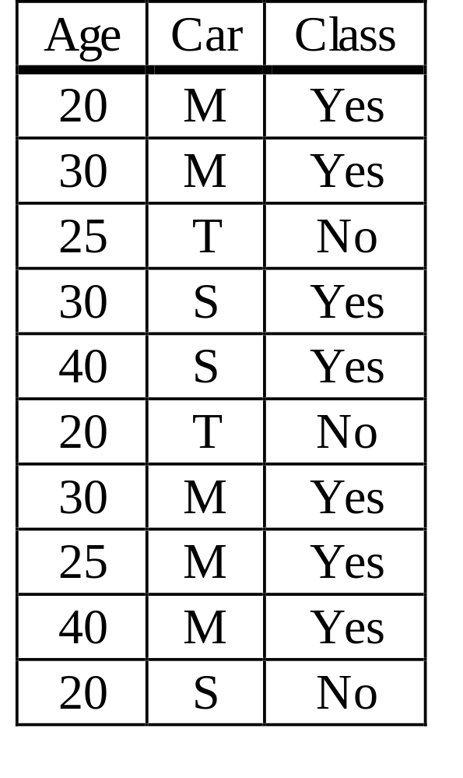
Classification Example
Example training database
  Two predictor attributes:
  Age and Car-type (Sport, Minivan and Truck)
  Age is ordered, Car-type is
  categorical attribute
  Class label indicates
  whether person bought
  product
  Dependent attribute is categorical

Slide 31
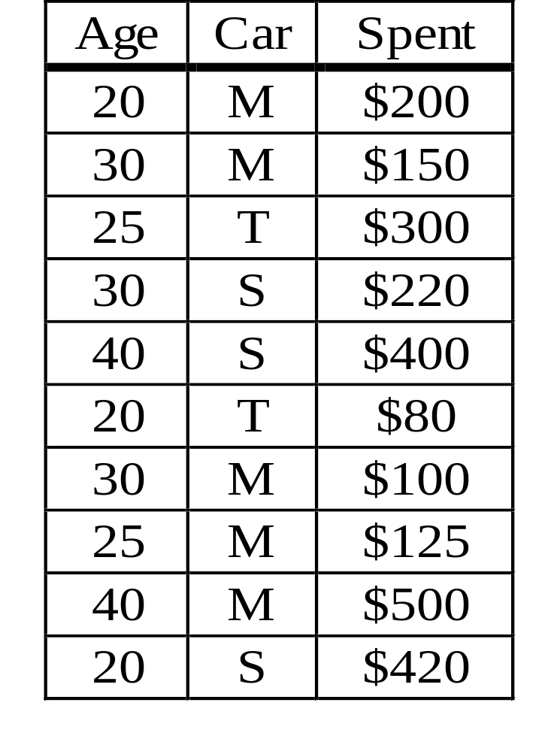
Regression Example
Example training database
  Two predictor attributes:
  Age and Car-type (Sport, Minivan and Truck)
  Spent indicates how much person spent during a recent visit to the web site
  Dependent attribute is numerical

Slide 32
Types of Variables (Review)
Numerical: Domain is ordered and can be represented on the real line (e.g., age, income)
Nominal or categorical: Domain is a finite set without any natural ordering (e.g., occupation, marital status, race)
Ordinal: Domain is ordered, but absolute differences between values is unknown (e.g., preference scale, severity of an injury)

Slide 33
Definitions
Random variables X₁, …, X_{k} (predictor variables) and Y (dependent variable)
X_{i} has domain dom(X_{i}), Y has domain dom(Y)
P is a probability distribution on
dom(X₁) x … x dom(X_{k}) x dom(Y)
Training database D is a random sample from P
A predictor d is a function
d: dom(X₁) … dom(X_{k}) → dom(Y)

Slide 34
Classification Problem
If Y is categorical, the problem is a classification problem, and we use C instead of Y.
|dom(C)| = J.
C is called the class label, d is called a classifier.
Take r be record randomly drawn from P.
Define the misclassification rate of d:
RT(d,P) = P(d(r.X₁, …, r.X_{k}) != r.C)
Problem definition: Given dataset D that is a random sample from probability distribution P, find classifier d such that RT(d,P) is minimized.

Slide 35
Regression Problem
If Y is numerical, the problem is a regression problem.
Y is called the dependent variable, d is called a regression function.
Take r be record randomly drawn from P.
Define mean squared error rate of d:
RT(d,P) = E(r.Y - d(r.X₁, …, r.X_{k}))²
Problem definition: Given dataset D that is a random sample from probability distribution P, find regression function d such that RT(d,P) is minimized.

Slide 36
Goals and Requirements
Goals:
  To produce an accurate classifier/regression function
  To understand the structure of the problem
Requirements on the model:
  High accuracy
  Understandable by humans, interpretable
  Fast construction for very large training databases

Slide 37
Different Types of Classifiers
Linear discriminant analysis (LDA)
Quadratic discriminant analysis (QDA)
Density estimation methods
Nearest neighbor methods
Logistic regression
Neural networks
Fuzzy set theory
Decision Trees

Slide 38
What are Decision Trees?
Age
Minivan
<30
>=30
YES
Sports,
Truck
YES
Car Type
YES
NO
Minivan
Sports, Truck
YES
NO
0
30
60
Age

Slide 39
Decision Trees
A decision tree T encodes d (a classifier or regression function) in form of a tree.
A node t in T without children is called a leaf node. Otherwise t is called an internal node.

Slide 40
Internal Nodes
Each internal node has an associated splitting predicate. Most common are binary predicates.
Example predicates:
  Age <= 20
  Profession in {student, teacher}
  5000*Age + 3*Salary – 10000 > 0

Slide 41
Internal Nodes: Splitting Predicates
Binary Univariate splits:
  Numerical or ordered X: X <= c, c in dom(X)
  Categorical X: X in A, A subset dom(X)
Binary Multivariate splits:
  Linear combination split on numerical variables:
  Σ a_{i}X_{i} <= c
k-ary (k>2) splits analogous

Slide 42
Leaf Nodes
Consider leaf node t
Classification problem: Node t is labeled with one class label c in dom(C)
Regression problem: Two choices
  Piecewise constant model:
  t is labeled with a constant y in dom(Y).
  Piecewise linear model:
  t is labeled with a linear model
  Y = y_{t} + Σ a_{i}X_{i}

Slide 43
Example
Encoded classifier:
If (age<30 and carType=Minivan)
Then YES
If (age <30 and
(carType=Sports or carType=Truck))
Then NO
If (age >= 30)
Then NO
Age
<30
>=30
Car Type
YES
Minivan
Sports, Truck
YES
NO

Slide 44
Evaluation of Misclassification Error
Problem:
In order to quantify the quality of a classifier d, we need to know its misclassification rate RT(d,P).
But unless we know P, RT(d,P) is unknown.
Thus we need to estimate RT(d,P) as good as possible.

Slide 45
Resubstitution Estimate
The Resubstitution estimate R(d,D) estimates RT(d,P) of a classifier d using D:
Let D be the training database with N records.
R(d,D) = 1/N Σ I(d(r.X) != r.C))
Intuition: R(d,D) is the proportion of training records that is misclassified by d
Problem with resubstitution estimate:
Overly optimistic; classifiers that overfit the training dataset will have very low resubstitution error.

Slide 46
Test Sample Estimate
Divide D into D₁ and D₂
Use D₁ to construct the classifier d
Then use resubstitution estimate R(d,D₂) to calculate the estimated misclassification error of d
Unbiased and efficient, but removes D₂ from training dataset D

Slide 47
V-fold Cross Validation
Procedure:
Construct classifier d from D
Partition D into V datasets D₁, …, D_{V}
Construct classifier d_{i} using D \ D_{i}
Calculate the estimated misclassification error R(d_{i},D_{i}) of d_{i} using test sample D_{i}
Final misclassification estimate:
Weighted combination of individual misclassification errors:
R(d,D) = 1/V Σ R(d_{i},D_{i})

Slide 48
Cross-Validation: Example
d
d₁
d₂
d₃

Slide 49
Cross-Validation
Misclassification estimate obtained through cross-validation is usually nearly unbiased
Costly computation (we need to compute d, and d₁, …, d_{V}); computation of d_{i} is nearly as expensive as computation of d
Preferred method to estimate quality of learning algorithms in the machine learning literature

Slide 50
Decision Tree Construction
Top-down tree construction schema:
  Examine training database and find best splitting predicate for the root node
  Partition training database
  Recurse on each child node

Slide 51
Top-Down Tree Construction
BuildTree(Node t, Training database D,
Split Selection Method S)
(1) Apply S to D to find splitting criterion
(2) if (t is not a leaf node)
(3) Create children nodes of t
(4) Partition D into children partitions
(5) Recurse on each partition
(6) endif

Slide 52
Decision Tree Construction
Three algorithmic components:
  Split selection (CART, C4.5, QUEST, CHAID, CRUISE, …)
  Pruning (direct stopping rule, test dataset pruning, cost-complexity pruning, statistical tests, bootstrapping)
  Data access (CLOUDS, SLIQ, SPRINT, RainForest, BOAT, UnPivot operator)

Slide 53
Split Selection Method
Numerical or ordered attributes: Find a split point that separates the (two) classes
(Yes: No: )
Age
30
35

Slide 54
Split Selection Method (Contd.)
Categorical attributes: How to group?
Sport: Truck: Minivan:
(Sport, Truck) -- (Minivan)
(Sport) --- (Truck, Minivan)
(Sport, Minivan) --- (Truck)

Slide 55
Pruning Method
For a tree T, the misclassification rate R(T,P) and the mean-squared error rate R(T,P) depend on P, but not on D.
The goal is to do well on records randomly drawn from P, not to do well on the records in D
If the tree is too large, it overfits D and does not model P. The pruning method selects the tree of the right size.

Slide 56
Data Access Method
Recent development: Very large training databases, both in-memory and on secondary storage
Goal: Fast, efficient, and scalable decision tree construction, using the complete training database.

Slide 57
Split Selection Methods
Multitude of split selection methods in the literature
In this workshop:
  CART

Slide 58
Split Selection Methods: CART
Classification And Regression Trees
(Breiman, Friedman, Ohlson, Stone, 1984;
considered “the” reference on decision tree construction)
Commercial version sold by Salford Systems
(www.salford-systems.com)
Many other, slightly modified implementations exist (e.g., IBM Intelligent Miner implements the CART split selection method)

Slide 59
CART Split Selection Method
Motivation: We need a way to choose quantitatively between different splitting predicates
  Idea: Quantify the impurity of a node
  Method: Select splitting predicate that generates children nodes with minimum impurity from a space of possible splitting predicates

Slide 60
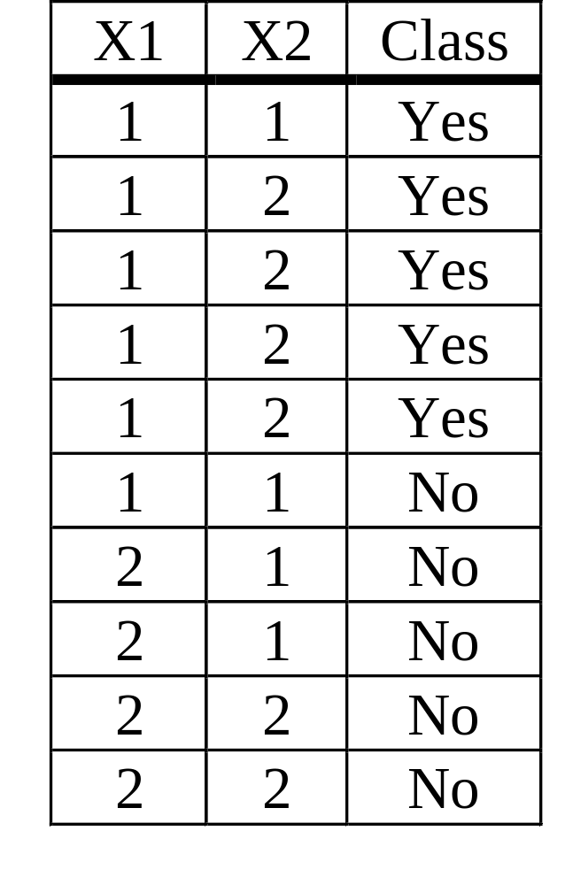
Intuition: Impurity Function
X1<=1 (50%,50%)
Yes
(83%,17%)
No
(0%,100%)
X2<=1 (50%,50%)
No
(25%,75%)
Yes
(66%,33%)

Slide 61
Impurity Function
Let p(j|t) be the proportion of class j training records at node t
Node impurity measure at node t:
i(t) = phi(p(1|t), …, p(J|t))
phi is symmetric
Maximum value at arguments (J⁻¹, …, J⁻¹) (maximum impurity)
phi(1,0,…,0) = … =phi(0,…,0,1) = 0
(node has records of only one class; “pure” node)

Slide 62
Example
Root node t:
p(1|t)=0.5; p(2|t)=0.5
Left child node t:
P(1|t)=0.83; p(2|t)=-.17
Impurity of root node:
phi(0.5,0.5)
Impurity of left child node:
phi(0.83,0.17)
Impurity of right child node:
phi(0.0,1.0)
X1<=1 (50%,50%)
Yes
(83%,17%)
No
(0%,100%)

Slide 63
Goodness of a Split
Consider node t with impurity phi(t)
The reduction in impurity through splitting predicate s (t splits into children nodes t_{L} with impurity phi(t_{L}) and t_{R} with impurity phi(t_{R})) is:
Δ_{phi}(s,t) = phi(t) – p_{L} phi(t_{L}) – p_{R} phi(t_{R})

Slide 64
Example (Contd.)
Impurity of root node:
phi(0.5,0.5)
Impurity of whole tree:
0.6* phi(0.83,0.17)
+ 0.4 * phi(0,1)
Impurity reduction:
phi(0.5,0.5)
- 0.6* phi(0.83,0.17)
- 0.4 * phi(0,1)
X1<=1 (50%,50%)
Yes
(83%,17%)
No
(0%,100%)

Slide 65
Error Reduction as Impurity Function
Possible impurity function:
Resubstitution error R(T,D).
Example:
R(no tree, D) = 0.5
R(T₁,D) = 0.6*0.17
R(T₂,D) =
0.4*0.25 + 0.6*0.33
T₁
X1<=1 (50%,50%)
Yes
(83%,17%)
No
(0%,100%)
T₂
X2<=1 (50%,50%)
No
(25%,75%)
Yes
(66%,33%)

Slide 66
Problems with Resubstitution Error
Obvious problem:
There are situations where no split can decrease impurity
Example:
R(no tree, D) = 0.2
R(T₁,D)
=0.6*0.17+0.4*0.25
=0.2
X3<=1 (80%,20%)
Yes
6: (83%,17%)
Yes
4: (75%,25%)

Slide 67
Problems with Resubstitution Error
More subtle problem:
X3<=1 8: (50%,50%)
X4<=1 (50%,50%)
Yes
4: (75%,25%)
No
4: (25%,75%)
No
6: (33%,66%)
Yes
2: (100%,0%)

Slide 68
Problems with Resubstitution Error
Root node: n records, q of class 1
Left child node: n1 records, q’ of class 1
Right child node: n2 records, (q-q’) of class 1,
n1+n2 = n
X3<=1 n: (q, (n-q))
Yes
n1: (q’/n1, (n1-q’)/n1)
Yes
n2: ((q-q’)/n2, (n2-(q-q’)/n2)

Slide 69
Problems with Resubstitution Error
Tree structure:
Root node: n records (q/n, (n-q))
Left child: n1 records (q’/n1, (n1-q’)/n1)
Right child: n2 records ((q-q’)/n2, (n2-q’)/n2)
Impurity before split:
Error: q/n
Impurity after split:
Left child: n1/n * q’/n1 = q’/n
Right child: n2/n * (q-q’)/n2 = (q-q’)/n
Total error: q’/n + (q-q’)/n = q/n

Slide 70
Problems with Resubstitution Error
Heart of the problem:
Assume two classes:
phi(p(1|t), p(2|t)) = phi(p(1|t), 1-p(1|t))
= phi (p(1|t))
Resubstitution errror has the following property:
phi(p1 + p2) = phi(p1)+phi(p2)

Slide 71
Example: Only Root Node
phi
X3<=1 8: (50%,50%)
0
0.5
1

Slide 72
Example: Split (75,25), (25,75)
phi
X3<=1 8: (50%,50%)
Yes
4: (75%,25%)
No
4: (25%,75%)
0
0.5
1

Slide 73
Example: Split (33,66), (100,0)
X4<=1 (80%,20%)
phi
No
6: (33%,66%)
Yes
2: (100%,0%)
0
0.5
1

Slide 74
Remedy: Concavity
Use impurity functions that are concave:
phi’’ < 0
Example impurity functions
Entropy:
phi(t) = - Σ p(j|t) log(p(j|t))
Gini index:
phi(t) = Σ p(j|t)²

Slide 75
Example Split With Concave Phi
X4<=1 (80%,20%)
phi
No
6: (33%,66%)
Yes
2: (100%,0%)
0
0.5
1

Slide 76
Nonnegative Decrease in Impurity
Theorem: Let phi(p₁, …, p_{J}) be a strictly concave function on j=1, …, J, Σ_{j} p_{j} = 1.
Then for any split s:
Δ_{phi}(s,t) >= 0
With equality if and only if:
p(j|t_{L}) = p(j|t_{R}) = p(j|t), j = 1, …, J
Note: Entropy and gini-index are concave.

Slide 77
CART Univariate Split Selection
Use gini-index as impurity function
For each numerical or ordered attribute X, consider all binary splits s of the form
X <= x
where x in dom(X)
For each categorical attribute X, consider all binary splits s of the form
X in A, where A subset dom(X)
At a node t, select split s* such that
Δ_{phi}(s*,t) is maximal over all s considered

Slide 78
CART: Shortcut for Categorical Splits
Computational shortcut if |Y|=2.
Theorem: Let X be a categorical attribute with dom(X) = {b₁, …, b_{k}}, |Y|=2, phi be a concave function, and let
p(X=b₁) <= … <= p(X=b_{k}).
Then the best split is of the form:
X in {b₁, b₂, …, b_{l}} for some l < k
Benefit: We need only to check k-1 subsets of dom(X) instead of 2^{(k-1)}-1 subsets

Slide 79
CART Multivariate Split Selection
For numerical predictor variables, examine splitting predicates s of the form:
Σ_{i} a_{i} X_{i} <= c
with the constraint:
Σ_{i} a_{i}² = 1
Select splitting predicate s* with maximum decrease in impurity.

Slide 80
Problems with CART Split Selection
Biased towards variables with more splits (M-category variable has 2^{M-1}-1) possible splits, an M-valued ordered variable has (M-1) possible splits
Computationally expensive for categorical variables with large domains

Slide 81
Pruning Methods
Test dataset pruning
Direct stopping rule
Cost-complexity pruning
MDL pruning
Pruning by randomization testing

Slide 82
Top-Down and Bottom-Up Pruning
Two classes of methods:
Top-down pruning: Stop growth of the tree at the right size. Need a statistic that indicates when to stop growing a subtree.
Bottom-up pruning: Grow an overly large tree and then chop off subtrees that “overfit” the training data.

Slide 83
Stopping Policies
A stopping policy indicates when further growth of the tree at a node t is counterproductive.
All records are of the same class
The attribute values of all records are identical
All records have missing values
At most one class has a number of records larger than a user-specified number
All records go to the same child node if t is split (only possible with some split selection methods)

Slide 84
Test Dataset Pruning
Use an independent test sample D’ to estimate the misclassification cost using the resubstitution estimate R(T,D’) at each node
Select the subtree T’ of T with the smallest expected cost

Slide 85

Test Dataset Pruning Example
Test set:
X1<=1 (50%,50%)
(83%,17%) X2<=1
No
(0%,100%)
No
(100%,0%)
Yes
(75%,25%)
Only root: 10% misclassification
Full tree: 30% misclassification

Slide 86
Cost Complexity Pruning
(Breiman, Friedman, Olshen, Stone, 1984)
Some more tree notation
t: node in tree T
leaf(T): set of leaf nodes of T
|leaf(T)|: number of leaf nodes of T
T_{t}: subtree of T rooted at t
{t}: subtree of T_{t} containing only node t

Slide 87
Notation: Example
leaf(T) = {t1,t2,t3}
|leaf(T)|=3
Tree rooted
at node t: T_{t}
Tree consisting
of only node t: {t}
leaf(T_{t})={t1,t2}
leaf({t})={t}
X1<=1
t: X2<=1
t3: No
t1: No
t2: Yes

Slide 88
Cost-Complexity Pruning
Test dataset pruning is the ideal case, if we have a large test dataset. But:
  We might not have a large test dataset
  We want to use all available records for tree construction
If we do not have a test dataset, we do not obtain “honest” classification error estimates
Remember cross-validation: Re-use training dataset in a clever way to estimate the classification error.

Slide 89
Cost-Complexity Pruning
/* cross-validation step */
Construct tree T using D
Partition D into V subsets D₁, …, D_{V}
for (i=1; i<=V; i++)
Construct tree T_{i} from (D \ D_{i})
Use D_{i} to calculate the estimate R(T_{i}, D \ D_{i})
endfor
/* estimation step */
Calculate R(T,D) from R(T_{i}, D \ D_{i})

Slide 90
Cross-Validation Step
R?
R₁
R₂
R₃

Slide 91
Cost-Complexity Pruning
Problem: How can we relate the misclassification error of the CV-trees to the misclassification error of the large tree?
Idea: Use a parameter that has the same meaning over different trees, and relate trees with similar parameter settings.
Such a parameter is the cost-complexity of the tree.

Slide 92
Cost-Complexity Pruning
Cost complexity of a tree T:
R_{alpha}(T) = R(T) + alpha |leaf(T)|
For each A, there is a tree that minimizes the cost complexity:
  alpha = 0: full tree
  alpha = infinity: only root node
alpha=0.4
alpha=0.6
alpha=0.0
alpha=0.25

Slide 93
Cost-Complexity Pruning
When should we prune the subtree rooted at t?
  R_{alpha}({t}) = R(t) + alpha
  R_{alpha}(T_{t}) = R(T_{t}) + alpha |leaf(T_{t})|
  Define
  g(t) = (R(t)-R(T_{t})) / (|leaf(T_{t})|-1)
Each node has a critical value g(t):
  Alpha < g(t): leave subtree T_{t} rooted at t
  Alpha >= g(t): prune subtree rooted at t to {t}
For each alpha we obtain a unique minimum cost-complexity tree.

Slide 94
Example Revisited
0<alpha<=0.2
0.2<alpha<=0.3
alpha>=0.45
0.3<alpha<0.45

Slide 95
Cost Complexity Pruning
Let T¹ > T² > … > {t} be the nested cost-complexity sequence of subtrees of T rooted at t.
Let alpha₁ < … < alpha_{k} be the sequence of associated critical values of alpha. Define alpha_{k’}=squareroot(alpha_{k} * alpha_{k+1})
Let T_{i} be the tree grown from D \ D_{i}
Let T^{i}(alpha_{k’}) be the minimal cost-complexity tree for alpha_{k’}

Slide 96
Cost Complexity Pruning
4. Let R’(T_{i})(alpha_{k’})) be the misclassification cost of T_{i}(alpha_{k’}) based on D_{i}
5. Define the V-fold cross-validation misclassification estimate as follows:
R*(T^{k}) = 1/V Σ_{i} R’(T_{i}(alpha_{k’}))
6. Select the subtree with the smallest estimated CV error

Slide 97
k-SE Rule
Let T* be the subtree of T that minimizes the misclassification error R(T_{k}) over all k
But R(T_{k}) is only an estimate:
  Estimate the estimated standard error SE(R(T*)) of R(T*)
  Let T** be the smallest tree such that
  R(T**) <= R(T*) + k*SE(R(T*)); use T** instead of T*
  Intuition: A smaller tree is easier to understand.

Slide 98
Cost Complexity Pruning
Advantages:
No independent test dataset necessary
Gives estimate of misclassification error, and chooses tree that minimizes this error
Disadvantages:
Originally devised for small datasets; is it still necessary for large datasets?
Computationally very expensive for large datasets (need to grow V trees from nearly all the data)

Slide 99
Missing Values
What is the problem?
  During computation of the splitting predicate, we can selectively ignore records with missing values (note that this has some problems)
  But if a record r misses the value of the variable in the splitting attribute, r can not participate further in tree construction
Algorithms for missing values address this problem.

Slide 100
Mean and Mode Imputation
Assume record r has missing value r.X, and splitting variable is X.
Simplest algorithm:
  If X is numerical (categorical), impute the overall mean (mode)
Improved algorithm:
  If X is numerical (categorical), impute the mean(X|t.C) (the mode(X|t.C))

Slide 101
Decision Trees: Summary
Many application of decision trees
There are many algorithms available for:
  Split selection
  Pruning
  Handling Missing Values
  Data Access
Decision tree construction still active research area (after 20+ years!)
Challenges: Performance, scalability, evolving datasets, new applications

Slide 102
Lecture Overview
Data Mining I: Decision Trees
Data Mining II: Clustering
Data Mining III: Association Analysis

Slide 103
Supervised Learning
F(x): true function (usually not known)
D: training sample drawn from F(x)
57,M,195,0,125,95,39,25,0,1,0,0,0,1,0,0,0,0,0,0,1,1,0,0,0,0,0,0,0,0 78,M,160,1,130,100,37,40,1,0,0,0,1,0,1,1,1,0,0,0,0,0,0,0,0,0,0,0,0,0 69,F,180,0,115,85,40,22,0,0,0,0,0,1,0,0,0,0,1,0,0,0,0,0,0,0,0,0,0,0,0 18,M,165,0,110,80,41,30,0,0,0,0,1,0,0,0,0,0,0,0,0,0,0,0,0,0,0,0,0,0 54,F,135,0,115,95,39,35,1,1,0,0,0,1,0,0,0,1,0,0,0,0,1,0,0,0,1,0,0,0,0 84,F,210,1,135,105,39,24,0,0,0,0,0,0,0,0,1,0,0,0,0,0,0,0,0,0,0,0,0,0 89,F,135,0,120,95,36,28,0,0,0,0,0,0,0,0,0,0,0,0,1,1,0,0,0,0,0,0,1,0,0 49,M,195,0,115,85,39,32,0,0,0,1,1,0,0,0,0,0,0,1,0,0,0,0,0,1,0,0,0,0 40,M,205,0,115,90,37,18,0,0,0,0,0,0,0,0,0,0,0,0,0,0,0,0,0,0,0,0,0,0 74,M,250,1,130,100,38,26,1,1,0,0,0,1,1,0,0,0,0,0,0,0,0,0,0,0,0,0,0 77,F,140,0,125,100,40,30,1,1,0,0,0,0,0,0,0,0,1,0,0,0,0,0,0,0,0,0,1,1 | 0 1 0 1 1 0 1 0 0 1 0

Slide 104
Supervised Learning
F(x): true function (usually not known)
D: training sample (x,F(x))
57,M,195,0,125,95,39,25,0,1,0,0,0,1,0,0,0,0,0,0,1,1,0,0,0,0,0,0,0,0 0
78,M,160,1,130,100,37,40,1,0,0,0,1,0,1,1,1,0,0,0,0,0,0,0,0,0,0,0,0,0 1
69,F,180,0,115,85,40,22,0,0,0,0,0,1,0,0,0,0,1,0,0,0,0,0,0,0,0,0,0,0,0 0
18,M,165,0,110,80,41,30,0,0,0,0,1,0,0,0,0,0,0,0,0,0,0,0,0,0,0,0,0,0 0
54,F,135,0,115,95,39,35,1,1,0,0,0,1,0,0,0,1,0,0,0,0,1,0,0,0,1,0,0,0,0 1
G(x): model learned from D 71,M,160,1,130,105,38,20,1,0,0,0,0,0,0,0,0,0,1,0,0,0,0,0,0,0,0,0,0 ?
Goal: E[(F(x)-G(x))²] is small (near zero) for future samples

Slide 105
Supervised Learning
Well-defined goal:
Learn G(x) that is a good approximation
to F(x) from training sample D
Well-defined error metrics:
Accuracy, RMSE, ROC, …

Slide 106
Supervised Learning
Training dataset:
Test dataset:
71,M,160,1,130,105,38,20,1,0,0,0,0,0,0,0,0,0,1,0,0,0,0,0,0,0,0,0,0 ?
57,M,195,0,125,95,39,25,0,1,0,0,0,1,0,0,0,0,0,0,1,1,0,0,0,0,0,0,0,0 78,M,160,1,130,100,37,40,1,0,0,0,1,0,1,1,1,0,0,0,0,0,0,0,0,0,0,0,0,0 69,F,180,0,115,85,40,22,0,0,0,0,0,1,0,0,0,0,1,0,0,0,0,0,0,0,0,0,0,0,0 18,M,165,0,110,80,41,30,0,0,0,0,1,0,0,0,0,0,0,0,0,0,0,0,0,0,0,0,0,0 54,F,135,0,115,95,39,35,1,1,0,0,0,1,0,0,0,1,0,0,0,0,1,0,0,0,1,0,0,0,0 84,F,210,1,135,105,39,24,0,0,0,0,0,0,0,0,1,0,0,0,0,0,0,0,0,0,0,0,0,0 89,F,135,0,120,95,36,28,0,0,0,0,0,0,0,0,0,0,0,0,1,1,0,0,0,0,0,0,1,0,0 49,M,195,0,115,85,39,32,0,0,0,1,1,0,0,0,0,0,0,1,0,0,0,0,0,1,0,0,0,0 40,M,205,0,115,90,37,18,0,0,0,0,0,0,0,0,0,0,0,0,0,0,0,0,0,0,0,0,0,0 74,M,250,1,130,100,38,26,1,1,0,0,0,1,1,0,0,0,0,0,0,0,0,0,0,0,0,0,0 77,F,140,0,125,100,40,30,1,1,0,0,0,0,0,0,0,0,1,0,0,0,0,0,0,0,0,0,1,1 | 0 1 0 1 1 0 1 0 0 1 0

Slide 107
Un-Supervised Learning
Training dataset:
Test dataset:
71,M,160,1,130,105,38,20,1,0,0,0,0,0,0,0,0,0,1,0,0,0,0,0,0,0,0,0,0 ?
57,M,195,0,125,95,39,25,0,1,0,0,0,1,0,0,0,0,0,0,1,1,0,0,0,0,0,0,0,0 78,M,160,1,130,100,37,40,1,0,0,0,1,0,1,1,1,0,0,0,0,0,0,0,0,0,0,0,0,0 69,F,180,0,115,85,40,22,0,0,0,0,0,1,0,0,0,0,1,0,0,0,0,0,0,0,0,0,0,0,0 18,M,165,0,110,80,41,30,0,0,0,0,1,0,0,0,0,0,0,0,0,0,0,0,0,0,0,0,0,0 54,F,135,0,115,95,39,35,1,1,0,0,0,1,0,0,0,1,0,0,0,0,1,0,0,0,1,0,0,0,0 84,F,210,1,135,105,39,24,0,0,0,0,0,0,0,0,1,0,0,0,0,0,0,0,0,0,0,0,0,0 89,F,135,0,120,95,36,28,0,0,0,0,0,0,0,0,0,0,0,0,1,1,0,0,0,0,0,0,1,0,0 49,M,195,0,115,85,39,32,0,0,0,1,1,0,0,0,0,0,0,1,0,0,0,0,0,1,0,0,0,0 40,M,205,0,115,90,37,18,0,0,0,0,0,0,0,0,0,0,0,0,0,0,0,0,0,0,0,0,0,0 74,M,250,1,130,100,38,26,1,1,0,0,0,1,1,0,0,0,0,0,0,0,0,0,0,0,0,0,0 77,F,140,0,125,100,40,30,1,1,0,0,0,0,0,0,0,0,1,0,0,0,0,0,0,0,0,0,1,1 | 0 1 0 1 1 0 1 0 0 1 0

Slide 108
Un-Supervised Learning
Training dataset:
Test dataset:
71,M,160,1,130,105,38,20,1,0,0,0,0,0,0,0,0,0,1,0,0,0,0,0,0,0,0,0,0 ?
57,M,195,0,125,95,39,25,0,1,0,0,0,1,0,0,0,0,0,0,1,1,0,0,0,0,0,0,0,0 78,M,160,1,130,100,37,40,1,0,0,0,1,0,1,1,1,0,0,0,0,0,0,0,0,0,0,0,0,0 69,F,180,0,115,85,40,22,0,0,0,0,0,1,0,0,0,0,1,0,0,0,0,0,0,0,0,0,0,0,0 18,M,165,0,110,80,41,30,0,0,0,0,1,0,0,0,0,0,0,0,0,0,0,0,0,0,0,0,0,0 54,F,135,0,115,95,39,35,1,1,0,0,0,1,0,0,0,1,0,0,0,0,1,0,0,0,1,0,0,0,0 84,F,210,1,135,105,39,24,0,0,0,0,0,0,0,0,1,0,0,0,0,0,0,0,0,0,0,0,0,0 89,F,135,0,120,95,36,28,0,0,0,0,0,0,0,0,0,0,0,0,1,1,0,0,0,0,0,0,1,0,0 49,M,195,0,115,85,39,32,0,0,0,1,1,0,0,0,0,0,0,1,0,0,0,0,0,1,0,0,0,0 40,M,205,0,115,90,37,18,0,0,0,0,0,0,0,0,0,0,0,0,0,0,0,0,0,0,0,0,0,0 74,M,250,1,130,100,38,26,1,1,0,0,0,1,1,0,0,0,0,0,0,0,0,0,0,0,0,0,0 77,F,140,0,125,100,40,30,1,1,0,0,0,0,0,0,0,0,1,0,0,0,0,0,0,0,0,0,1,1 | 0 1 0 1 1 0 1 0 0 1 0

Slide 109
Un-Supervised Learning
Data Set:
57,M,195,0,125,95,39,25,0,1,0,0,0,1,0,0,0,0,0,0,1,1,0,0,0,0,0,0,0,0 78,M,160,1,130,100,37,40,1,0,0,0,1,0,1,1,1,0,0,0,0,0,0,0,0,0,0,0,0,0 69,F,180,0,115,85,40,22,0,0,0,0,0,1,0,0,0,0,1,0,0,0,0,0,0,0,0,0,0,0,0 18,M,165,0,110,80,41,30,0,0,0,0,1,0,0,0,0,0,0,0,0,0,0,0,0,0,0,0,0,0 54,F,135,0,115,95,39,35,1,1,0,0,0,1,0,0,0,1,0,0,0,0,1,0,0,0,1,0,0,0,0 84,F,210,1,135,105,39,24,0,0,0,0,0,0,0,0,1,0,0,0,0,0,0,0,0,0,0,0,0,0 89,F,135,0,120,95,36,28,0,0,0,0,0,0,0,0,0,0,0,0,1,1,0,0,0,0,0,0,1,0,0 49,M,195,0,115,85,39,32,0,0,0,1,1,0,0,0,0,0,0,1,0,0,0,0,0,1,0,0,0,0 40,M,205,0,115,90,37,18,0,0,0,0,0,0,0,0,0,0,0,0,0,0,0,0,0,0,0,0,0,0 74,M,250,1,130,100,38,26,1,1,0,0,0,1,1,0,0,0,0,0,0,0,0,0,0,0,0,0,0 77,F,140,0,125,100,40,30,1,1,0,0,0,0,0,0,0,0,1,0,0,0,0,0,0,0,0,0,1,1

Slide 110
Supervised vs. Unsupervised Learning
Supervised
y=F(x): true function
D: labeled training set
D: {x_{i},F(x_{i})}
Learn:
G(x): model trained to predict labels D
Goal:
E[(F(x)-G(x))²] ≈ 0
Well defined criteria: Accuracy, RMSE, ...
Unsupervised
Generator: true model
D: unlabeled data sample
D: {x_{i}}
Learn
??????????
Goal:
??????????
Well defined criteria:
??????????

Slide 111
What to Learn/Discover?
Statistical Summaries
Generators
Density Estimation
Patterns/Rules
Associations (see previous segment)
Clusters/Groups (this segment)
Exceptions/Outliers
Changes in Patterns Over Time or Location

Slide 112
Clustering: Unsupervised Learning
Given:
  Data Set D (training set)
  Similarity/distance metric/information
Find:
  Partitioning of data
  Groups of similar/close items

Slide 113
Similarity?
Groups of similar customers
  Similar demographics
  Similar buying behavior
  Similar health
Similar products
  Similar cost
  Similar function
  Similar store
  …
Similarity usually is domain/problem specific

Slide 114
Distance Between Records
d-dim vector space representation and distance metric
r₁: 57,M,195,0,125,95,39,25,0,1,0,0,0,1,0,0,0,0,0,0,1,1,0,0,0,0,0,0,0,0
r₂: 78,M,160,1,130,100,37,40,1,0,0,0,1,0,1,1,1,0,0,0,0,0,0,0,0,0,0,0,0,0
...
r_{N}: 18,M,165,0,110,80,41,30,0,0,0,0,1,0,0,0,0,0,0,0,0,0,0,0,0,0,0,0,0,0
Distance (r₁,r₂) = ???
Pairwise distances between points (no d-dim space)
    Similarity/dissimilarity matrix
    (upper or lower diagonal)
    Distance: 0 = near, ∞ = far
    Similarity: 0 = far, ∞ = near
-- 1 2 3 4 5 6 7 8 9 10
1 - d d d d d d d d d
2 - d d d d d d d d
3 - d d d d d d d
4 - d d d d d d
5 - d d d d d
6 - d d d d
7 - d d d
8 - d d
9 - d

Slide 115
Properties of Distances: Metric Spaces
A metric space is a set S with a global distance function d. For every two points x, y in S, the distance d(x,y) is a nonnegative real number.
A metric space must also satisfy
  d(x,y) = 0 iff x = y
  d(x,y) = d(y,x) (symmetry)
  d(x,y) + d(y,z) >= d(x,z) (triangle inequality)

Slide 116
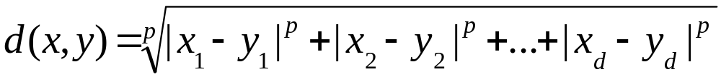
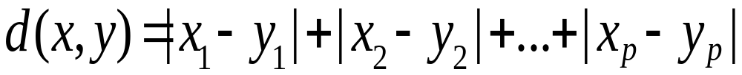
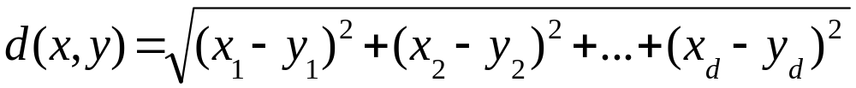
Minkowski Distance (L_{p} Norm)
Consider two records x=(x₁,…,x_{d}), y=(y₁,…,y_{d}):
Special cases:
p=1: Manhattan distance
p=2: Euclidean distance

Slide 117
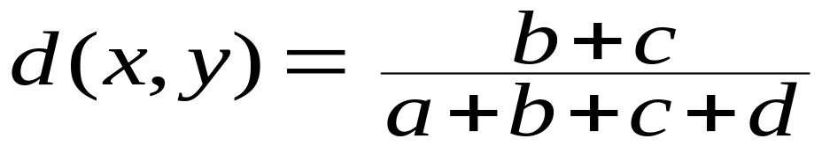
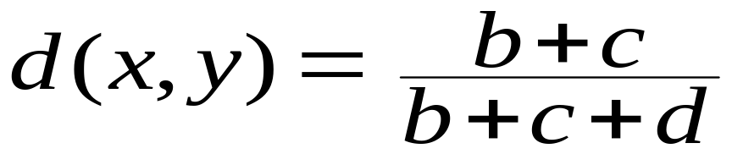
Only Binary Variables
2x2 Table:
Simple matching coefficient:
(symmetric)
Jaccard coefficient:
(asymmetric)
 | 0 | 1 | Sum
0 | a | b | a+b
1 | c | d | c+d
Sum | a+c | b+d | a+b+c+d

Slide 118
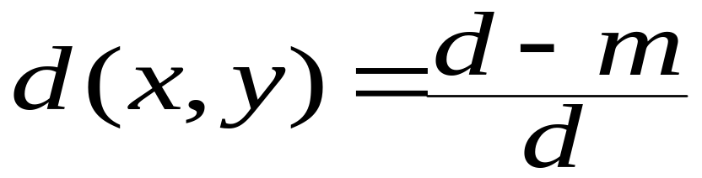
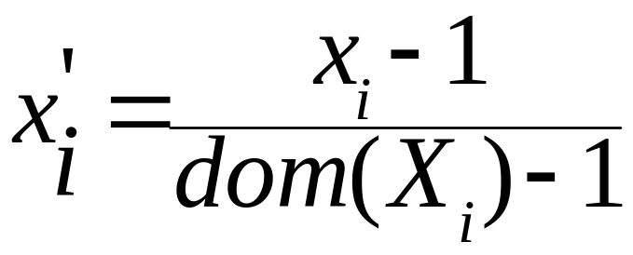
Nominal and Ordinal Variables
Nominal: Count number of matching variables
  m: # of matches, d: total # of variables
Ordinal: Bucketize and transform to numerical:
  Consider record x with value x_{i} for i^{th} attribute of record x; new value x_{i}’:

Slide 119
Mixtures of Variables
Weigh each variable differently
Can take “importance” of variable into account (although usually hard to quantify in practice)

Slide 120
Clustering: Informal Problem Definition
Input:
A data set of N records each given as a d-dimensional data feature vector.
Output:
Determine a natural, useful “partitioning” of the data set into a number of (k) clusters and noise such that we have:
  High similarity of records within each cluster (intra-cluster similarity)
  Low similarity of records between clusters (inter-cluster similarity)

Slide 121
Types of Clustering
Hard Clustering:
  Each object is in one and only one cluster
Soft Clustering:
  Each object has a probability of being in each cluster

Slide 122
Clustering Algorithms
Partitioning-based clustering
  K-means clustering
  K-medoids clustering
  EM (expectation maximization) clustering
Hierarchical clustering
  Divisive clustering (top down)
  Agglomerative clustering (bottom up)
Density-Based Methods
  Regions of dense points separated by sparser regions of relatively low density

Slide 123
K-Means Clustering Algorithm
Initialize k cluster centers
Do
Assignment step: Assign each data point to its closest cluster center
Re-estimation step: Re-compute cluster centers
While (there are still changes in the cluster centers)
Visualization at:
http://www.delft-cluster.nl/textminer/theory/kmeans/kmeans.html

Slide 124
Issues
Why is K-Means working:
How does it find the cluster centers?
Does it find an optimal clustering
What are good starting points for the algorithm?
What is the right number of cluster centers?
How do we know it will terminate?

Slide 125
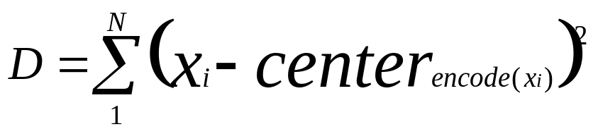
K-Means: Distortion
Communication between sender and receiver
Sender encodes dataset: x_{i} → {1,…,k}
Receiver decodes dataset: j → center_{j}
Distortion:
A good clustering has minimal distortion.

Slide 126

Properties of the Minimal Distortion
Recall: Distortion
Property 1: Each data point x_{i} is encoded by its nearest cluster center center_{j}. (Why?)
Property 2: When the algorithm stops, the partial derivative of the Distortion with respect to each center attribute is zero.

Slide 127
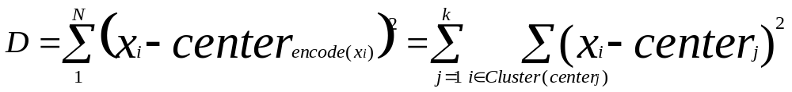
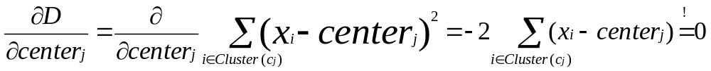
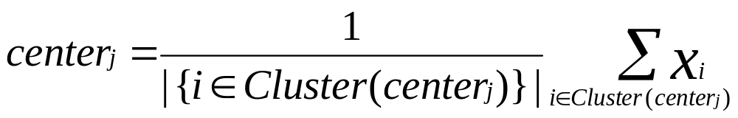
Property 2 Followed Through
Calculating the partial derivative:
Thus at the minimum:

Slide 128
K-Means Minimal Distortion Property
Property 1: Each data point x_{i} is encoded by its nearest cluster center center_{j}
Property 2: Each center is the centroid of its cluster.
How do we improve a configuration:
  Change encoding (encode a point by its nearest cluster center)
  Change the cluster center (make each center the centroid of its cluster)

Slide 129
K-Means Minimal Distortion Property (Contd.)
Termination? Count the number of distinct configurations …
Optimality? We might get stuck in a local optimum.
  Try different starting configurations.
  Choose the starting centers smart.
Choosing the number of centers?
  Hard problem. Usually choose number of clusters that minimizes some criterion.

Slide 130
K-Means: Summary
Advantages:
  Good for exploratory data analysis
  Works well for low-dimensional data
  Reasonably scalable
Disadvantages
  Hard to choose k
  Often clusters are non-spherical

Slide 131
K-Medoids
Similar to K-Means, but for categorical data or data in a non-vector space.
Since we cannot compute the cluster center (think text data), we take the “most representative” data point in the cluster.
This data point is called the medoid (the object that “lies in the center”).

Slide 132
Agglomerative Clustering
Algorithm:
Put each item in its own cluster (all singletons)
Find all pairwise distances between clusters
Merge the two closest clusters
Repeat until everything is in one cluster
Observations:
Results in a hierarchical clustering
Yields a clustering for each possible number of clusters
Greedy clustering: Result is not “optimal” for any cluster size

Slide 133
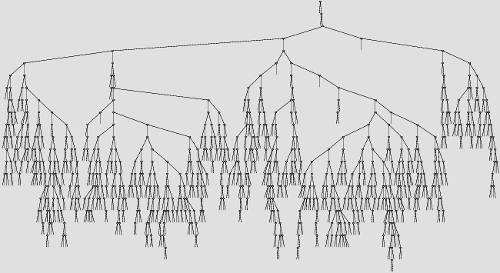
Agglomerative Clustering Example

Slide 134
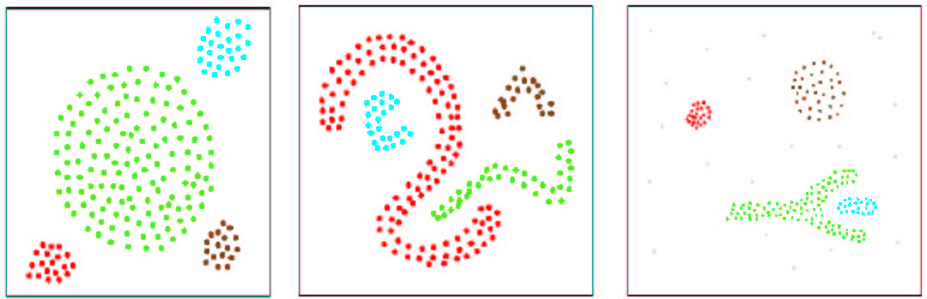
Density-Based Clustering
A cluster is defined as a connected dense component.
Density is defined in terms of number of neighbors of a point.
We can find clusters of arbitrary shape

Slide 135
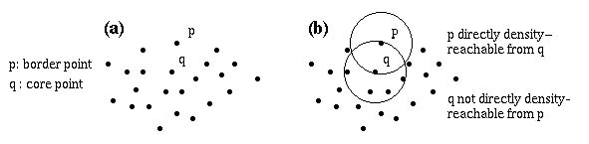
DBSCAN
E-neighborhood of a point
  NE(p) = {q ∈D | dist(p,q) ≤ E}
Core point
  |NE(q)| ≥ MinPts
Directly density-reachable
  A point p is directly density-reachable from a point q wrt. E, MinPts if
  1) p ∈ NE(q) and
  2) |NE(q)| ≥ MinPts (core point condition).

Slide 136
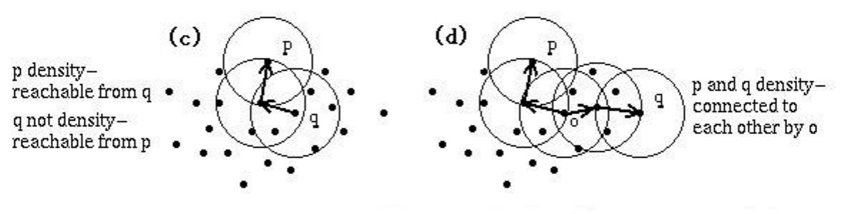
DBSCAN
Density-reachable
  A point p is density-reachable from a point q wrt. E and MinPts if there is a chain of points p₁, ..., p_{n}, p₁ = q, p_{n} = p such that p_{i+1} is directly density-reachable from p_{i}
Density-connected
  A point p is density-connected to a point q wrt. E and MinPts if there is a point o such that both, p and q are density-reachable from o wrt. E and MinPts.

Slide 137
DBSCAN
Cluster
A cluster C satisfies:
1) ∀ p, q: if p ∈ C and q is density-reachable from p wrt. E and MinPts, then q ∈ C. (Maximality)
2) ∀ p, q ∈ C: p is density-connected to q wrt. E and MinPts. (Connectivity)
Noise
Those points not belonging to any cluster

Slide 138
DBSCAN
Can show
(1) Every density-reachable set is a cluster:
The set
O = {o | o is density-reachable from p wrt. Eps and MinPts}
is a cluster wrt. Eps and MinPts.
(2) Every cluster is a density-reachable set:
Let C be a cluster wrt. Eps and MinPts and let p be any point in C with |N_{Eps}(p)| ≥ MinPts. Then C equals to the set
O = {o | o is density-reachable from p wrt. Eps and MinPts}.
This motivates the following algorithm:
For each point, DBSCAN determines the Eps-environment and checks whether it contains more than MinPts data points
If so, it labels it with a cluster number
If a neighbor q of a point p has already a cluster number, associate this number with p

Slide 139
DBSCAN
Arbitrary shape clusters found by DBSCAN

Slide 140
DBSCAN: Summary
Advantages:
  Finds clusters of arbitrary shapes
Disadvantages:
  Targets low dimensional spatial data
  Hard to visualize for >2-dimensional data
  Needs clever index to be scalable
  How do we set the magic parameters?

Slide 141
Lecture Overview
Data Mining I: Decision Trees
Data Mining II: Clustering
Data Mining III: Association Analysis

Slide 142
Market Basket Analysis
Consider shopping cart filled with several items
Market basket analysis tries to answer the following questions:
  Who makes purchases?
  What do customers buy together?
  In what order do customers purchase items?

Slide 143
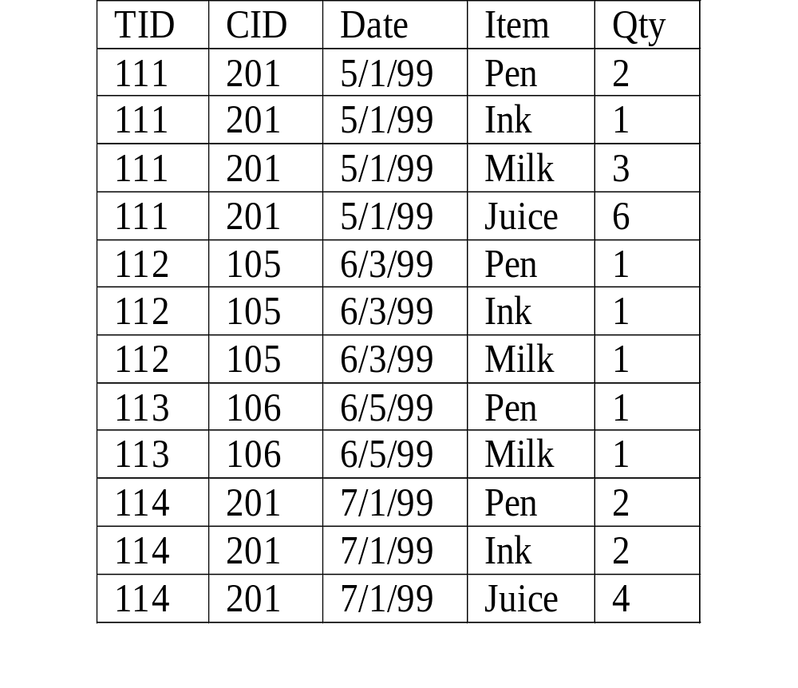
Market Basket Analysis
Given:
A database of customer transactions
Each transaction is a set of items
Example:
Transaction with TID 111 contains items {Pen, Ink, Milk, Juice}

Slide 144
Market Basket Analysis (Contd.)
Coocurrences
  80% of all customers purchase items X, Y and Z together.
Association rules
  60% of all customers who purchase X and Y also buy Z.
Sequential patterns
  60% of customers who first buy X also purchase Y within three weeks.

Slide 145
Confidence and Support
We prune the set of all possible association rules using two interestingness measures:
Confidence of a rule:
  X → Y has confidence c if P(Y|X) = c
Support of a rule:
  X → Y has support s if P(XY) = s
We can also define
Support of an itemset (a coocurrence) XY:
  XY has support s if P(XY) = s

Slide 146
Example
Examples:
{Pen} => {Milk}
Support: 75%
Confidence: 75%
{Ink} => {Pen}
Support: 100%
Confidence: 100%

Slide 147
Example
Find all itemsets with
support >= 75%?

Slide 148
Example
Can you find all association rules with support >= 50%?

Slide 149
Market Basket Analysis: Applications
Sample Applications
  Direct marketing
  Fraud detection for medical insurance
  Floor/shelf planning
  Web site layout
  Cross-selling

Slide 150
Applications of Frequent Itemsets
Market Basket Analysis
Association Rules
Classification (especially: text, rare classes)
Seeds for construction of Bayesian Networks
Web log analysis
Collaborative filtering

Slide 151
Association Rule Algorithms
More abstract problem redux
Breadth-first search
Depth-first search

Slide 152
Problem Redux
Abstract:
A set of items {1,2,…,k}
A dabase of transactions (itemsets) D={T1, T2, …, Tn},
Tj subset {1,2,…,k}
GOAL:
Find all itemsets that appear in at least x transactions
(“appear in” == “are subsets of”)
I subset T: T supports I
For an itemset I, the number of transactions it appears in is called the support of I.
x is called the minimum support.
Concrete:
I = {milk, bread, cheese, …}
D = { {milk,bread,cheese}, {bread,cheese,juice}, …}
GOAL:
Find all itemsets that appear in at least 1000 transactions
{milk,bread,cheese} supports {milk,bread}

Slide 153
Problem Redux (Contd.)
Definitions:
An itemset is frequent if it is a subset of at least x transactions. (FI.)
An itemset is maximally frequent if it is frequent and it does not have a frequent superset. (MFI.)
GOAL: Given x, find all frequent (maximally frequent) itemsets (to be stored in the FI (MFI)).
Obvious relationship:
MFI subset FI
Example:
D={ {1,2,3}, {1,2,3}, {1,2,3}, {1,2,4} }
Minimum support x = 3
{1,2} is frequent
{1,2,3} is maximal frequent
Support({1,2}) = 4
All maximal frequent itemsets: {1,2,3}

Slide 154
The Itemset Lattice
{}
{1}
{2}
{3}
{4}
{1,2}
{1,3}
{1,4}
{2,3}
{2,4}
{3,4}
{1,2,3}
{1,2,4}
{1,3,4}
{2,3,4}
{1,2,3,4}

Slide 155
Frequent Itemsets
{}
{1}
{2}
{3}
{4}
{1,2}
{1,3}
{1,4}
{2,3}
{2,4}
{3,4}
{1,2,3}
{1,2,4}
{1,3,4}
{2,3,4}
{1,2,3,4}
Frequent itemsets
Infrequent itemsets

Slide 156
Breath First Search: 1-Itemsets
{}
{1}
{2}
{3}
{4}
{1,2}
{1,3}
{1,4}
{2,3}
{2,4}
{3,4}
{1,2,3}
{1,2,4}
{1,3,4}
{2,3,4}
Infrequent
Frequent
Currently examined
Don’t know
{1,2,3,4}
The Apriori Principle:
I infrequent ➔ (I union {x}) infrequent

Slide 157
Breath First Search: 2-Itemsets
{}
{1}
{2}
{3}
{4}
{1,2}
{1,3}
{1,4}
{2,3}
{2,4}
{3,4}
{1,2,3}
{1,2,4}
{1,3,4}
{2,3,4}
Infrequent
Frequent
Currently examined
Don’t know
{1,2,3,4}

Slide 158
Breath First Search: 3-Itemsets
{}
{1}
{2}
{3}
{4}
{1,2}
{1,3}
{1,4}
{2,3}
{2,4}
{3,4}
{1,2,3}
{1,2,4}
{1,3,4}
{2,3,4}
Infrequent
Frequent
Currently examined
Don’t know
{1,2,3,4}

Slide 159
Breadth First Search: Remarks
We prune infrequent itemsets and avoid to count them
To find an itemset with k items, we need to count all 2^{k} subsets

Slide 160
Depth First Search (1)
{}
{1}
{2}
{3}
{4}
{1,2}
{1,3}
{1,4}
{2,3}
{2,4}
{3,4}
{1,2,3}
{1,2,4}
{1,3,4}
{2,3,4}
Infrequent
Frequent
Currently examined
Don’t know
{1,2,3,4}

Slide 161
Depth First Search (2)
{}
{1}
{2}
{3}
{4}
{1,2}
{1,3}
{1,4}
{2,3}
{2,4}
{3,4}
{1,2,3}
{1,2,4}
{1,3,4}
{2,3,4}
Infrequent
Frequent
Currently examined
Don’t know
{1,2,3,4}

Slide 162
Depth First Search (3)
{}
{1}
{2}
{3}
{4}
{1,2}
{1,3}
{1,4}
{2,3}
{2,4}
{3,4}
{1,2,3}
{1,2,4}
{1,3,4}
{2,3,4}
Infrequent
Frequent
Currently examined
Don’t know
{1,2,3,4}

Slide 163
Depth First Search (4)
{}
{1}
{2}
{3}
{4}
{1,2}
{1,3}
{1,4}
{2,3}
{2,4}
{3,4}
{1,2,3}
{1,2,4}
{1,3,4}
{2,3,4}
Infrequent
Frequent
Currently examined
Don’t know
{1,2,3,4}

Slide 164
Depth First Search (5)
{}
{1}
{2}
{3}
{4}
{1,2}
{1,3}
{1,4}
{2,3}
{2,4}
{3,4}
{1,2,3}
{1,2,4}
{1,3,4}
{2,3,4}
Infrequent
Frequent
Currently examined
Don’t know
{1,2,3,4}

Slide 165
Depth First Search: Remarks
We prune frequent itemsets and avoid counting them (works only for maximal frequent itemsets)
To find an itemset with k items, we need to count k prefixes

Slide 166
BFS Versus DFS
Breadth First Search
Prunes infrequent itemsets
Uses anti-monotonicity: Every superset of an infrequent itemset is infrequent
Depth First Search
Prunes frequent itemsets
Uses monotonicity: Every subset of a frequent itemset is frequent

Slide 167
Extensions
Imposing constraints
  Only find rules involving the dairy department
  Only find rules involving expensive products
  Only find “expensive” rules
  Only find rules with “whiskey” on the right hand side
  Only find rules with “milk” on the left hand side
  Hierarchies on the items
  Calendars (every Sunday, every 1st of the month)

Slide 168
Itemset Constraints
Definition:
A constraint is an arbitrary property of itemsets.
Examples:
The itemset has support greater than 1000.
No element of the itemset costs more than $40.
The items in the set average more than $20.
Goal:
Find all itemsets satisfying a given constraint P.
“Solution”:
If P is a support constraint, use the Apriori Algorithm.

Slide 169
Negative Pruning in Apriori
{}
{1}
{2}
{3}
{4}
{1,2}
{1,3}
{1,4}
{2,3}
{2,4}
{3,4}
{1,2,3}
{1,2,4}
{1,3,4}
{2,3,4}
Frequent
Infrequent
Currently examined
Don’t know
{1,2,3,4}

Slide 170
Negative Pruning in Apriori
{}
{1}
{2}
{3}
{4}
{1,2}
{1,3}
{1,4}
{2,3}
{2,4}
{3,4}
{1,2,3}
{1,2,4}
{1,3,4}
{2,3,4}
Frequent
Infrequent
Currently examined
Don’t know
{1,2,3,4}

Slide 171
Negative Pruning in Apriori
{}
{1}
{2}
{3}
{4}
{1,2}
{1,3}
{1,4}
{2,3}
{2,4}
{3,4}
{1,2,3}
{1,2,4}
{1,3,4}
{2,3,4}
Frequent
Infrequent
Currently examined
Don’t know
{1,2,3,4}

Slide 172
Two Trivial Observations
Apriori can be applied to any constraint P that is antimonotone.
  Start from the empty set.
  Prune supersets of sets that do not satisfy P.
Itemset lattice is a boolean algebra, so Apriori also applies to a monotone Q.
  Start from set of all items instead of empty set.
  Prune subsets of sets that do not satisfy Q.

Slide 173
Negative Pruning a Monotone Q
{}
{1}
{2}
{3}
{4}
{1,2}
{1,3}
{1,4}
{2,3}
{2,4}
{3,4}
{1,2,3}
{1,2,4}
{1,3,4}
{2,3,4}
Satisfies Q
Doesn’t satisfy Q
Currently examined
Don’t know
{1,2,3,4}

Slide 174
Positive Pruning in Apriori
{}
{1}
{2}
{3}
{4}
{1,2}
{1,3}
{1,4}
{2,3}
{2,4}
{3,4}
{1,2,3}
{1,2,4}
{1,3,4}
{2,3,4}
Frequent
Infrequent
Currently examined
Don’t know
{1,2,3,4}

Slide 175
Positive Pruning in Apriori
{}
{1}
{2}
{3}
{4}
{1,2}
{1,3}
{1,4}
{2,3}
{2,4}
{3,4}
{1,2,3}
{1,2,4}
{1,3,4}
{2,3,4}
Frequent
Infrequent
Currently examined
Don’t know
{1,2,3,4}

Slide 176
Positive Pruning in Apriori
{}
{1}
{2}
{3}
{4}
{1,2}
{1,3}
{1,4}
{2,3}
{2,4}
{3,4}
{1,2,3}
{1,2,4}
{1,3,4}
{2,3,4}
Frequent
Infrequent
Currently examined
Don’t know
{1,2,3,4}

Slide 177
Classifying Constraints
Antimonotone:
support(I) > 1000
max(I) < 100
Neither:
average(I) > 50
variance(I) < 2
3 < sum(I) < 50
Monotone:
sum(I) > 3
min(I) < 40
  These are the
  constraints we
  really want.

Slide 178
The Problem Redux
Current Techniques:
Approximate the difficult constraints.
Monotone approximations are common.
New Goal:
Given constraints P and Q, with P antimonotone (support) and Q monotone (statistical constraint).
Find all itemsets that satisfy both P and Q.
Recent solutions:
Newer algorithms can handle both P and Q

Slide 179

Conceptual Illustration of Problem
{}
All supersets satisfy Q
Satisfies Q
Satisfies P & Q
Satisfies P
All subsets satisfy P
D

Slide 180
Applications
Spatial association rules
Web mining
Market basket analysis
User/customer profiling

Slide 181
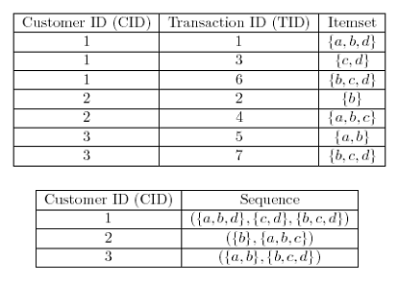
Extensions: Sequential Patterns

